Slide 1
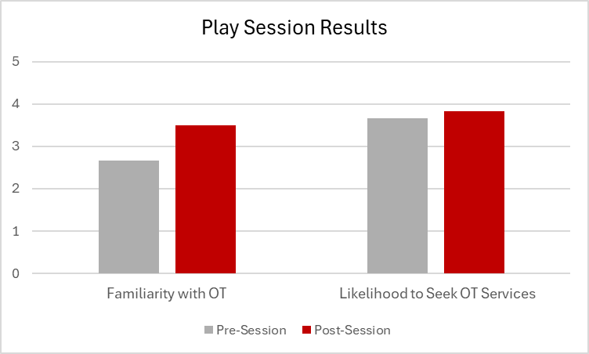
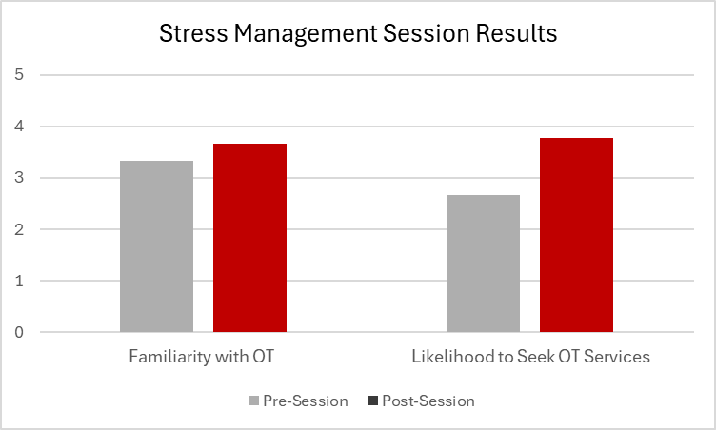
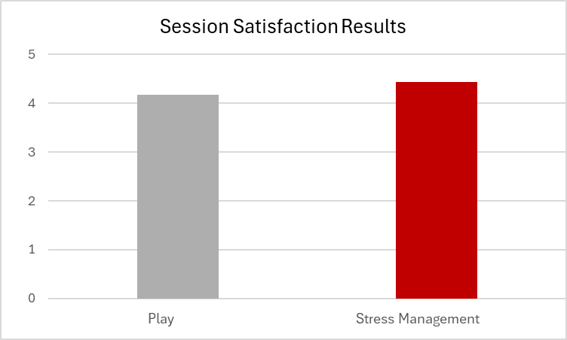
Empowering Pregnancy and Postpartum: Supporting Motherhood Through Occupational Therapy Education Alison Drexler, OTS Faculty Mentor: Karen Hebert PhD, OTR/L
PURPOSE
METHODS
Occupation-Based Session Survey Results
DISCUSSION & CONCLUSION
To develop and implement educational and occupation-based sessions using occupational therapy concepts to integrate into a community parenting program.
To advocate for the role of occupational therapy in pregnancy and postpartum.
Topics for supplemental educational materials were determined to include attachment, infant massage, habit changes, exercise, and more.
Topics for nurse-led course materials were determined with the nursing staff to include positions to prepare for delivery, postpartum depression strategies, strategies for round ligament pain, and more.
Supplemental educational materials included single-page handouts that were created and shared during the corresponding LifePath parenting sessions, specialty course sessions, and nurse-led sessions.
Occupation-based sessions were offered at a transitional housing program for women and children via outreach, and at the pregnancy center.
Participants were recruited from those enrolled in the LifePath parenting sessions.
Four sessions were offered via outreach including topics on promoting play 0-6 months, 6-12 months, and 12-18 months, and stress management.
Attendance at the outreach site for sessions ranged from 1-5 for each session, with a total of six participants attending at least one.
One session was offered at the pregnancy center on stress management with four participants in attendance.
Personally developed surveys were provided before and after all occupation-based sessions.
The quantitative data indicates that occupation-based sessions are an effective strategy to increase awareness and knowledge of occupational therapy concepts related to pregnancy, postpartum, and caring for children.
The education topics utilized for the supplemental materials and occupation-based sessions provided participants with relevant information and strategies that they could apply to their lives during the major transition to parenthood.
Limitations of this project included client sample size, client population, lack of standardized outcome measure, and the lack of a full-length program.
Occupational therapy practitioners may provide support during pregnancy and postpartum through education.
All objectives were fulfilled throughout the capstone project and experience.
BACKGROUND
Maternal mortality rates have been increasing, with a 71% increase seen over three years. (Hoyert, 2023).
Maternal psychological and physical health is at increased risk due to life changes and transitions (Graham, 2020; Pizur-Barnekow, 2010; Sanders & Morse, 2005).
Unintended pregnancies, which occur in 41% of pregnancies, are associated with negative consequences for maternal and infant health (Bahk et al., 2015; Khajehpour et al., 2013).
The transition to motherhood includes significant occupational changes within roles, routines, and responsibilities which can be very challenging and affect the mother’s physical and psychological health (Graham, 2020).
THEORETICAL FOUNDATION
IMPLICATIONS
The Model of Human Occupation (MOHO)
MOHO views individuals holistically, with a whole-person
perspective, focusing on the connection between the mind
and the body (Kielhofner, 2008). MOH can be applied to
maternal health and motherhood to help explain
occupational needs. It addresses the relationship between
their motivation and the complex occupation patterns
required during the perinatal period. MOHO can then be
used to adjust habits and behaviors to improve their
performance capacity ensuring they can successfully carry
out their maternal occupations (Graham, 2020).
The Perinatal Maternal Health Promotion Model
This model targets building life skills to promote well-
being in women during the perinatal period (Fahey &
Shenassa, 2013). It can be applied to occupational
therapy as they are equipped to provide women with
education, and prevention and promotion interventions
to improve physical recovery, increase skills in coping,
goal-setting, and identifying social supports (AOTA,
2020).
Occupational therapists are equipped with the knowledge and skills to support women during pregnancy and postpartum.
Occupation-based sessions can be an effective way to provide education and intervention during the perinatal period.
There is a need for increased postpartum support for women, specifically with unintended pregnancies.
Additional research is warranted on the direct effect of occupational therapy intervention on promoting mental and physical health in the perinatal period.
RESULTS
Evaluation of survey responses indicated on average that participants’ familiarity with occupational therapy and their likelihood to seek out occupational therapy services increased following the completion of an occupation-based session.
Participants reported overall satisfaction with the occupation-based sessions.
Open-ended survey responses indicated occupational therapy would be beneficial in a variety of areas.
A folder of approximately 30 educational materials was created and shared with pregnancy center staff.
REFERENCES

