Slide 1
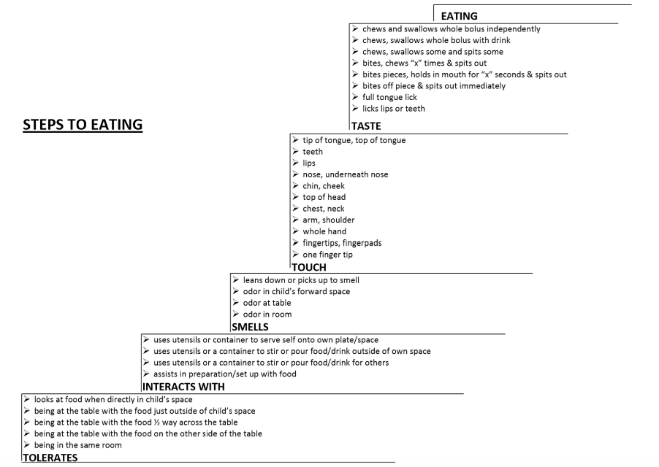
Occupational Therapy’s Role as a Member of an Interdisciplinary Feeding Team for Children with Sensory Processing Differences Emily Bruinsma Faculty Mentor: Ranelle Nissen, PhD, OTR/L Site Mentor: Rachel Fratzke, OTD, OTR/L
BACKGROUND & PURPOSE
RESULTS
DISCUSSION
Feeding is an important occupation, as it provides the body with the nutrients it needs to survive and occurs approximately five to eight times per day for children (Centers for Disease Control and Prevention, 2021). However, 27% of children have difficulties with feeding, and 3% of children under the age of five are diagnosed with a pediatric feeding disorder (Benjasuwantep et al., 2013; Kovacic et al., 2020). Therefore, it is important that all healthcare professionals understand their role when it comes to addressing feeding concerns in children.
When working with a child on feeding, there are four elements that have been described in the literature as being important to include in feeding therapy treatments: caregiver involvement, use of an interdisciplinary team, sensory interventions, and family-centered and motivating interventions. First, caregivers are more likely to implement techniques used during feeding therapy into their daily routines when they are more involved in the treatment process, and caregivers report a variety of benefits to their family’s interactions when this occurs (An, 2013; Bachmeyer-Lee et al., 2020; Caldwell et al., 2018; Caldwell et al., 2022; Hoyo & Kadlec, 2021). Next, using an interdisciplinary team to address feeding concerns has been shown to be more effective than any one discipline working alone (Williams et al., 2017). There are psychological, medical, motor, and behavioral aspects to feeding, and it is important that each of these be addressed by various members of an interdisciplinary team (Clawson & Elliott, 2014; McComish et al., 2016). On top of this, children with sensory processing challenges benefit from sensory preparation activities to help them become regulated before beginning a mealtime (Howe & Wang, 2013; Hoyo & Kadlec, 2021; Mallick et al., 2017; Seiverling et al., 2018 Williams et al., 2017). Specifically, children benefit through improved transitions to mealtime, reduced mealtime behaviors, improved parent-child interactions, and decreased drooling (Mallick et al., 2017; Seiverling et al., 2018). Finally, children have been shown to make better progress and feel happier when their treatments are motivating and reinforcing to them (Budhan et al., 2019; Caldwell et al., 2018; Howe & Wang, 2013; Phipps et al., 2022). Parents also report preferring interventions that are family-centered and take the individual needs of each family into account (Hoyo & Kadlec, 2021; Simione et al., 2020).
Purpose: This doctoral capstone focused on identifying occupational therapy’s role on an interdisciplinary feeding team for children with sensory processing challenges. Through in-depth clinical experiences related to pediatric feeding therapy and creating educational materials for caregivers and graduate students from a variety of healthcare disciplines, I sought to develop competence in administering sensory integration-based feeding interventions and assessments, while also improving my communication, leadership, and collaboration skills to better support my future practice.
Primary Outcomes: Overall, my capstone was a success, as each of my goals and desired results were achieved without any significant changes to my original plan. I was able to develop expertise in pediatric feeding therapy and develop competency in sensory integration-based feeding interventions and assessments. I was also able to create feeding menus for children with common dietary restrictions and a variety of patient education materials on topics related to feeding therapy. Creating these materials allowed me to further practice skills needed to provide feeding therapy while also enhancing my ability to communicate effectively with caregivers. In addition, I was able to gain familiarity with a variety of pediatric feeding assessments, and I created a resource tool identifying the important features of each one to assist in clinical practice and evaluations. I also created a tracking log and documented the progress that each child I worked with made over time to determine the overall effectiveness of SI-based feeding therapy on improving children’s interactions with foods. On top of this, I wrote a comprehensive case study to assist in explaining the feeding therapy process to others. Finally, I created a PowerPoint presentation that was presented to the current cohort of students in an interdisciplinary healthcare training program. This helped to improve my leadership and communication skills, while also educating other professionals on this topic.
Data Analysis: For data analysis, I categorized each food based on the physical properties of the foods. These categories included meltable hard solids, soft cubes, soft mechanical single texture, soft mechanical mixed texture, hard mechanicals, and purees. I then recorded the step number according to the SOS Steps to Eating Hierarchy that each child reached at their initial presentation of the food and at their final presentation of the food. This allowed me to calculate a mean for each child’s initial and final levels of interactions within each food category. The means of each child in each category were then analyzed using a Wilcoxon signed-rank test to determine what changes, if any, occurred. The soft cubes and soft mechanical mixed texture categories were shown to have statistically significant (p < .05) changes in the children's level of interactions with the foods from initial presentation to final presentation. While not yet showing significant results, the hard mechanical texture category was approaching significance. The purees, meltable hard solids, and soft mechanical single texture categories were not shown to have statistically significant changes in the children's levels of interactions with the foods from initial presentation to final presentation. The results for each food category can be found in Table 1.
Four components that are important to include in any feeding therapy program are caregiver involvement, use of an interdisciplinary team, sensory interventions, and family-centered and motivating interventions. Therefore, I sought to address each of these during my capstone. First, I created a variety of patient education materials to better educate the families of children receiving feeding therapy services and improve my communication skills. Through clinical observation, I have seen the benefit that occurs when caregivers are highly involved in their child’s care. This emphasizes the continued need to include caregivers in the feeding therapy process and ensure there are educational materials available to assist with their understanding of the approaches and strategies used. Next, I gained significant experience working with an interdisciplinary team in the clinic, and I also gained interdisciplinary collaboration skills by presenting to a training program for graduate students from a variety of healthcare disciplines. Clinically, I have seen the value of interdisciplinary collaboration, as children benefit when their providers communicate about their care plan and incorporate strategies from other disciplines into their treatments. In addition, incorporating sensory interventions has been shown to be an effective strategy to use during feeding therapy sessions. Clinically, I have observed this to be true, as several of the treatment sessions I have been involved in begin with sensory preparation activities to help regulate the child prior to moving to the table. I have been able to observe the benefits that come from these activities, as the children often are able to better engage with the foods when their sensory needs are met first. Finally, it is important to include motivating and family-centered interventions during the feeding therapy process. Clinically, I have observed this to be especially true. Children are significantly more likely to engage when the foods are presented in ways that are motivating for them, such as incorporating their favorite play schemes or characters into the interactions with the foods. On top of this, the needs of the family must be considered when making recommendations for home programming. I have observed that families are significantly more likely to implement therapy recommendations when they align more closely with the family’s pre-existing beliefs, attitudes, and structures. The further from these the recommendations are, the less likely it seems the families will be successful in incorporating them into their daily routines.
In addition, results of data analysis showed that sensory integration-based feeding therapy techniques are effective at improving children’s interactions with soft cubes and soft mechanical single texture foods. Children’s interactions with hard mechanical foods were also approaching significance. However, no significant changes were observed for purees, meltable hard solid, and soft mechanical mixed texture foods. This may be due to the small sample size, limited exposure to certain foods, and inconsistent attendance for some participants, though.
Table 1
Results of Statistical Analysis Per Food Category
METHODS
Food Category | Z | p
Meltable Hard Solids | -1.83 | 0.23
Soft Cubes | -2.34 | 0.02
Soft Mechanical, Single Texture | -0.18 | 0.86
Soft Mechanical, Mixed Texture | -2.10 | 0.04
Hard Mechanical | -1.70 | 0.09
Purees | -1.21 | 0.23
The primary goal of my capstone was to develop competence in sensory integration-based interventions and assessments. To do this, I completed the SOS Approach to Feeding training conference, a variety of additional training courses and webinars, weekly interdisciplinary feeding evaluations, and feeding therapy treatment sessions with occupational therapists and speech-language pathologists. I also created feeding menus that can be used during feeding therapy treatments for children with dietary restrictions, a resource tool of various feeding assessments that could be used during an evaluation, and several patient education materials to help support my progress towards this goal.
On top of this, I had a goal to determine the effectiveness of sensory integration-based feeding interventions. To accomplish this, I tracked the progress each child I worked with for sensory integration-based feeding therapy made by recording the step number on the Steps to Eating Hierarchy that the child reached at their first presentation of a food and at their final presentation of a food. Only children who met the qualification criteria outlined by the SOS Approach were included. I began with 11 participants, but two of these children were discharged prior to the end of my capstone and were therefore excluded from data analysis. This resulted in a sample of nine children between the ages of 15 months and 11 years. This data was analyzed using a Wilcoxon signed-rank test to determine what changes, if any, occurred. I also wrote a comprehensive case study documenting the evaluation and treatment of a child receiving feeding therapy services from an interdisciplinary team to help me gain a more thorough understanding of this process.
My final goal was to improve my leadership and interprofessional collaboration skills. This was accomplished by presenting to a class of graduate students in an interprofessional training program, presenting to a group of caregivers of children receiving feeding therapy, and creating an additional patient education handout on this topic.
THEORETICAL FOUNDATION
IMPLICATIONS
The Sensory Integration theory was the guiding theory for this doctoral capstone. This theory describes how the body’s sensory systems are organized and function, and it identifies the patterns of self-regulation that exist (Ayres, 1989). It also identifies specific sensations that can alert or calm an individual (Ayres, 1989). This was useful during my capstone, as it helped me to better understand each child’s sensory needs so that I could prepare interventions that would be most regulating for them. Another concept outlined by the Sensory Integration theory is the importance of using play-based interventions, which helped me understand the benefit of incorporating play into my feeding therapy sessions to help children remain regulated and engaged with the feeding tasks (Ayres, 1989). Overall, this theory helped me to better understand the sensory complexities that exist with feeding so that I could best meet the needs of each child I worked with.
These results all highlight various implications for the field of occupational therapy as a whole. Specifically, occupational therapy practitioners should strive to include caregivers in the feeding therapy process as much as possible. They should also work with an interdisciplinary team to ensure all of the client’s needs are met. In addition, it may be beneficial to incorporate sensory integration activities to help children remain regulated during feeding. On top of this, practitioners should ensure their interventions are family-centered and motivating for the individual child. Finally, data analysis shows that sensory integration-based techniques are effective for improving children’s interactions with some food textures, and practitioners should continue to use these strategies. Additional research is needed in this area to determine the overall effectiveness for all foods, though.
REFERENCES
https://docs.google.com/document/d/1y4uqsPDGbyTZIetIW6AnWXcQh5sSeRMxZ2r0zH-9758/edit?usp=sharing
REFERENCES

