Slide 1
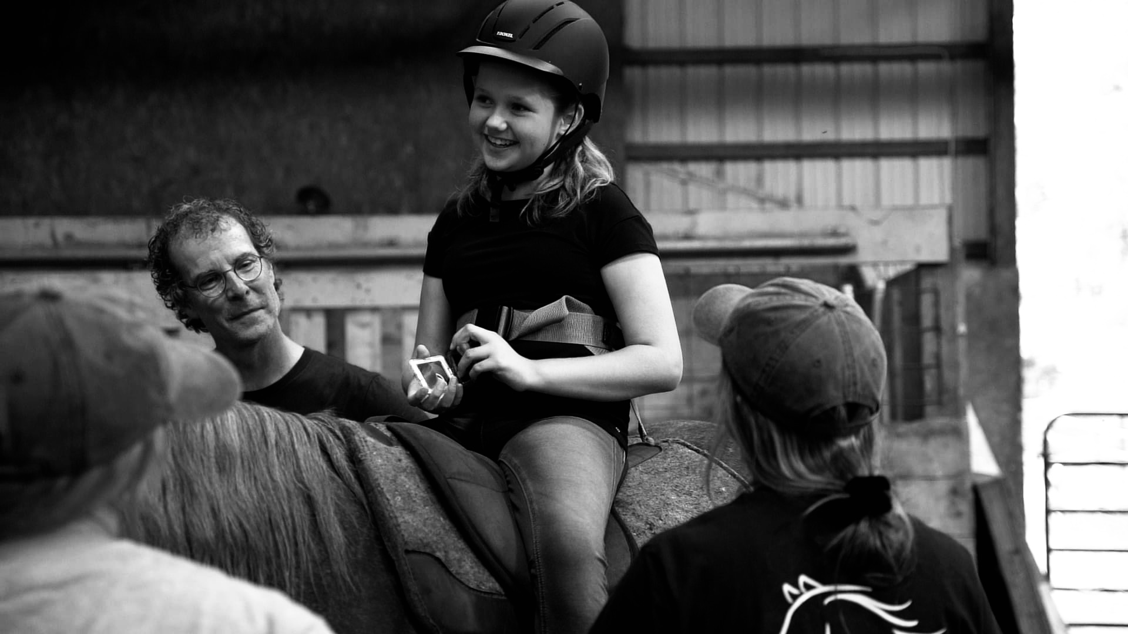
Say Neigh to Poor Health: Exploring the Impact of Equine Assisted Services on Children’s Health By Courtney Barrus, OTS Faculty mentor: Dr. Allison Naber
BACKGROUND & PURPOSE
THEORETICAL FOUNDATION
Discussion/Conclusion
Background: One in six children in the United States has a developmental disability that can negatively influence an individual's ability to solve problems, social skills, life skills, ability to form relationships, and ability to learn (Centers of Disease Control and Prevention [CDC], 2022; US Department of Health and Human Services, 2021). Many treatments help these children, including equine-assisted services (Angsupaisal, 2015; Coan, 2020; Llambias et al., 2016; Lovrić et al., 2020; US National Library of Medicine, 2017). Equine-assisted services are mounted and unmounted activities, including adaptive riding and hippotherapy (Cagle-Holtcamp, 2022; PATH Intl., 2023; Wood et al., 2021). Adaptive riding focuses on teaching children horsemanship skills, while hippotherapy includes therapy services provided by a licensed professional. (American Hippotherapy Association, 2022; PATH Intl., 2023; Wood et al.,
2021).
Purpose: This capstone aimed to gain in-depth clinical experience in hippotherapy and explore the impact of equine-assisted services on the child's overall social, emotional, and family health.
This capstone project was guided by two theories. The Environmental Health Occupational Well-Being (E-HOW) is a holistic theory that breaks health into social, physical, mental/emotional, family, occupational, and spiritual health. It dives into the interacting components of health, environments and occupational participation (Pizzi, 2001; Pizzi & Richards, 2017). The E-HOW guided the use of the PHWA and the semi-structured interview to focus on social, family, and mental/emotional health and how adaptive riding impacts health. The Social Participation frame of reference dives into a child’s function and dysfunction with emotional regulation, family habits and routines, environment support at home, environment support in school, environments for peer interaction, and peer interaction. The Social Participation frame of reference guided the use of the ERC, SDQ, and semi-structured interview to understand adaptive riding’s role in helping a child improve emotional regulation and social participation with peers and family
During my capstone experience, I was able to create a submission-ready manuscript. The E-HOW and the social participation theories helped determine the use of the ERC, SDQ, and PHWA. In addition, they helped guide the questions for the semi-structured interview. Creating the manuscript expanded my ability to perform qualitative research and conduct an interview. The research taught me more about the children's health and the parents' perspective on adaptive riding. As I learned more about implementing hippotherapy, I gained a more in-depth knowledge of the assessments, interventions, supplies, and diagnoses commonly seen in hippotherapy. I learned more about the benefits of using the horse's movement to help children and how different professions use hippotherapy. Additionally, I recognized the foundational principles of hippotherapy, which can be translated into other settings. The information gathered through my capstone can provide me with detailed information to be used in future professions, even if it isn't in hippotherapy. The research will also be used to expand current evidence of the role adaptive riding has on a child's health.
RESULTS
Adaptive Riding Research Study: Eleven participants with children aged 0-18 agreed to participate. All participants spent one session with the capstone student, reviewing and signing the consent form, completing all measures, and completing a semi-structured interview. The quantitative data was analyzed using the Statistical Package Science program (SPSS) for Windows, version 28.0 (2022). The qualitative data was analyzed using a content analysis (Leedy & Ormrod, 2019). The capstone student transcribed and coded the recordings based on adaptive riding, social, emotional, and family health. Themes were identified based on common ideas from the parents, and descriptive information was added to support each theme (Leedy & Ormrod, 2019). All information was added to a submission-ready manuscript.
In-depth Clinical Experience of Hippotherapy: The capstone student observed and
participated in hippotherapy sessions implemented by speech pathologists, physical therapists, and occupational therapists. Additionally, the capstone student reached out to sites that offer hippotherapy. The capstone student created an assessment document from this information with a general description, age range, cost, and details on obtaining the assessment. In addition, an intervention schematic was created based on mounted and unmounted activities. Based on the children seen, a diagnoses schematic was created, differentiating diagnoses seen and the percentage of each diagnosis. A supplies schematic was developed based on adaptive riding and the hippotherapy sessions. The final component was a post to the CommunOT website (2024) explaining the role of physical therapists, speech pathologists, and occupational therapists when implementing hippotherapy.
METHODS
Participants: In-depth clinical experience was gained while working with children enrolled in hippotherapy at the Making Strides Foundation. Research participants were parents of an adaptive riding program at the same facility. Procedures & Activities: During the first half of the capstone, the research study was the main focus. Research participants engaged in one session where they completed three assessments and a semi-structured interview. The second half of the capstone focused on gaining in-depth clinical experience while learning about the implementation of treatments, common diagnoses, assessments, and different professions that implement hippotherapy. Assessment Instruments: Pizzi Health and Wellness Assessment (PHWA), Emotional Regulation Checklist (ERC), Strengths and Difficulties Questionnaire (SDQ), and a semi-structured interview were used to gauge the impact of adaptive riding on a child’s social, emotional, and family health.
Picture from the Making Strides Foundation.
IMPLICATIONS
REFERENES
The submission-ready manuscript will be submitted to a peer-reviewed journal. This will assist in defining the benefits of adaptive riding. However, continued research would be beneficial to see the impact of adaptive riding on social, mental, and family health. The in-depth clinical experience provided an opportunity to learn about hippotherapy and how the various components of this intervention can target different diagnoses. The foundational skills can be transferred to a more traditional site, such as using movement to meet sensory needs. Additionally, posting about hippotherapy can spread awareness of its benefits and uses.
Please use this QR code to review my reference list. Thank you!

